Slide 1
College Name
Topic : BIG DATA

Slide 2

BIG DATA

Slide 3
OVERVIEW
PROBLEM STATEMENT
INTRODUCTION
DATASET
ALGORITHM
IMPLEMENTATION
RESULT
CONCLUSION

Slide 4

PROBLEM STATEMENT
Large number of products are available on online
Searching for required products on e-commerce website is very difficult

Slide 5

INTRODUCTION
WHAT IS BIGDATA?

Slide 6
HADOOP
WHY HADOOP?
LARGE STORAGE
HDFS
DISTRIBUTED COMPUTING
MAPREDUCE

Slide 7
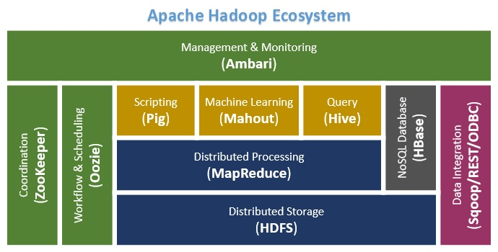

Slide 8

HDFS
DISTRIBUTED FILE SYSTEM USED TO RUN ON COMMODITY HARDWAARE

Slide 9
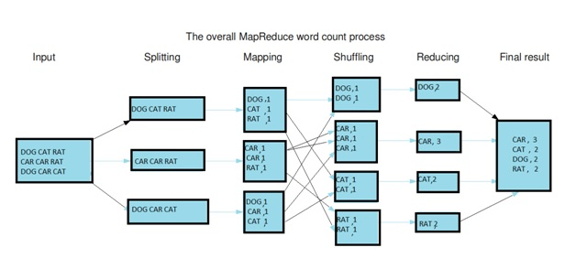
MAPREDUCE

Slide 10
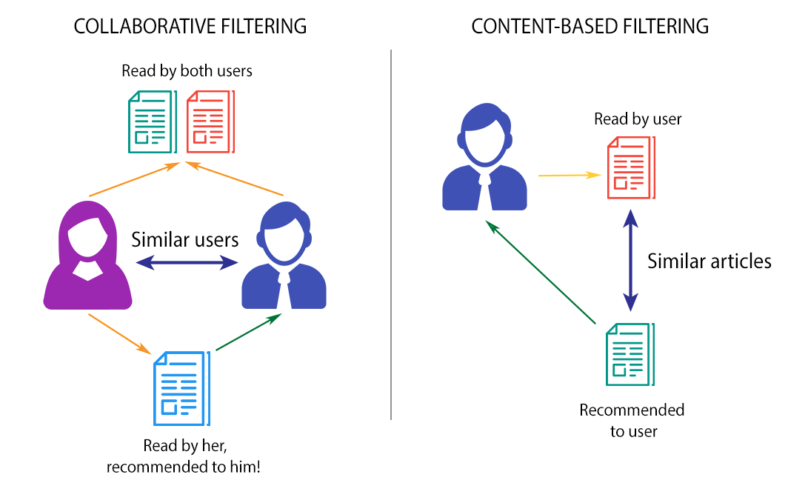
WHAT IS RECOMMENDATION SYSTEM???
INFORMATION FILTERING

Slide 11
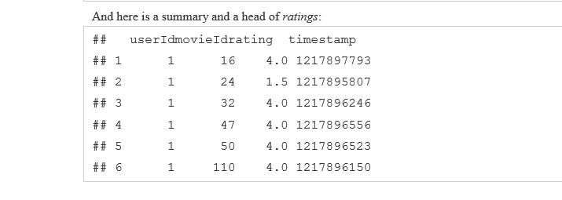
DATASET
DATASET COLLECTED FROM MOVIELENSE WEBSITE

Slide 12
IMPLEMENTATION
USING TECHNOLOGIES
HADOOP
R
R PACKAGES
RECOMMENDERLAB
GGPLOT2

Slide 13
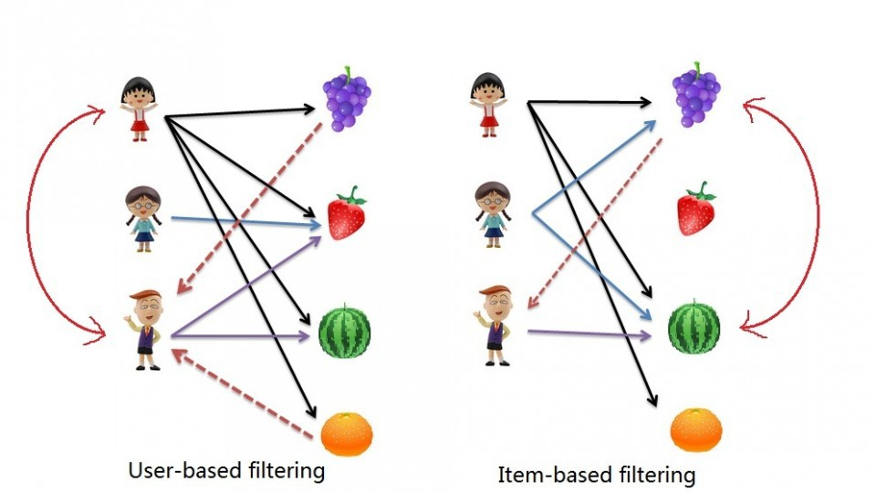
METHOD
WE ARE USING USER BASED COLLABORATIVE METHOD(UBCF)

Slide 14
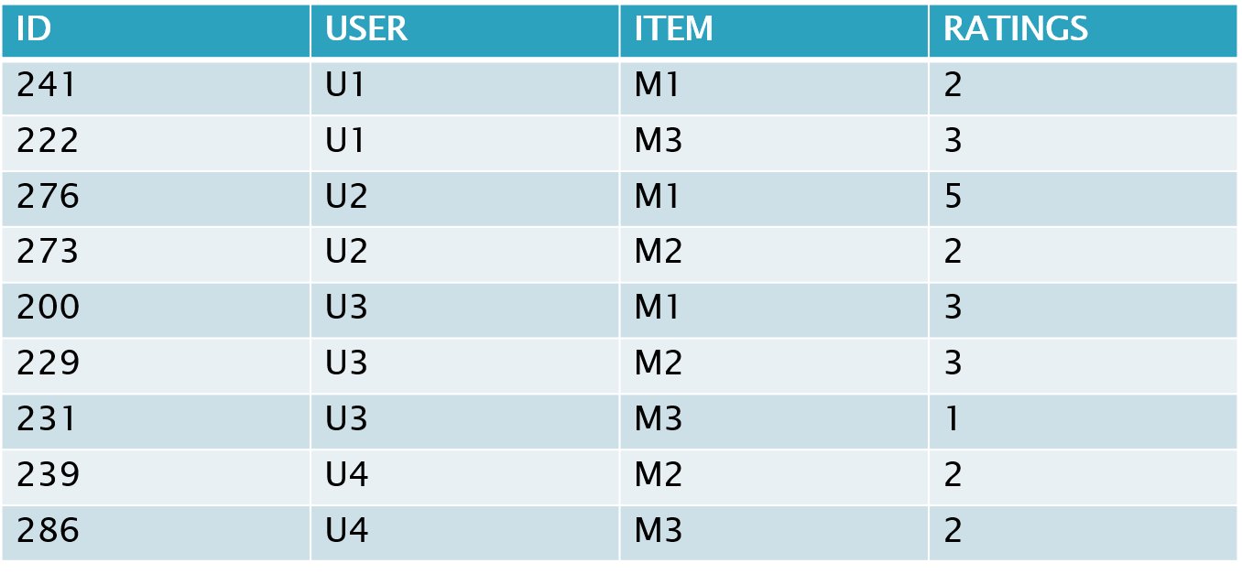
COSINE SIMILARITY METHOD

Slide 15
CONTINUE…
REWRITE THE ABOVE TABLE AS A USER-ITEM RATINGS DATA IN A MATRIX
In the above table both m1 and m2 have been rated by users u2 and u3.
Create two item-vectors v1 for item m1 and v2 for item m2 in the use space of (u2,u3) and then find cosine angles between vectors.
A zero angle or overlapping vectors with cosine value 1 means total similarity and an angle of 90 degrees mean cosine of 0, no similarity.
Thus, two item vectors be:
V1=5u2+3u3
V2=3u2+3u3

Slide 16
CONTINUE…
The cosine similarity between v1&v2 :
Cos(v1,v2)=[(5*3+3*3)/sqrt((25+9)*(9+9 ))]= 0.76
Similarly calculate for m1&m3, we consider u1&u3 who rated both these items.
v1=2u1+3u3
v3=3u1+1u3
Cos(v1,v3)=[(2*3+3*1)/sqrt((4+9)*(9+1))]= 0.78
Item m2&m3 using users u3&u4. The two item-vectors would be:
v2=3u3+2u4
v3=1u3+2u4
Cos(v2,v3)=[(3*1+2*2)/sqrt((9+4)*(1+4))]= 0.86
Now the complete item-to-item similarity matrix as follows:

Slide 17
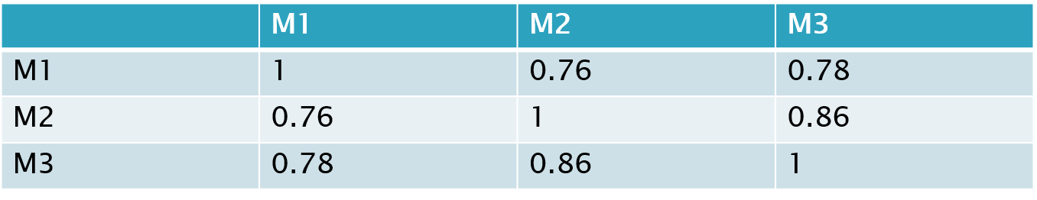
CONTINUE...
For each user , we next predict his ratings for items he ha s not rated.
We calculate rating for user u1 in case of item m2.To weigh this the just-calculated similarity between target item and other items that user had already rated, the weighing factor is rating.
We further scale this weighted sum with the sum of similarity-measures so the calculated rating remain within predefined.
For item m2 for user u1 will be calculated suing similarity between (m2,m1)&(m1,m3) weighted by respective rating for m1 and m3.
Rating=(2*0.76+3*0.86)/(0.76+0.86) = 2.53

Slide 18
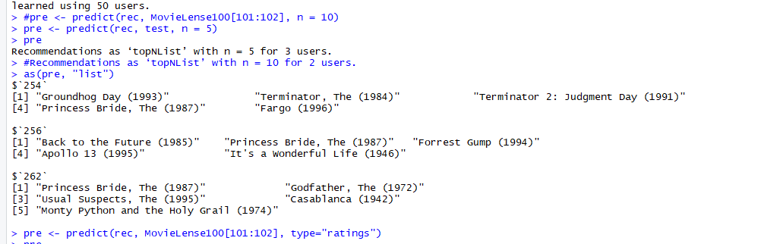
RESULT

Slide 19
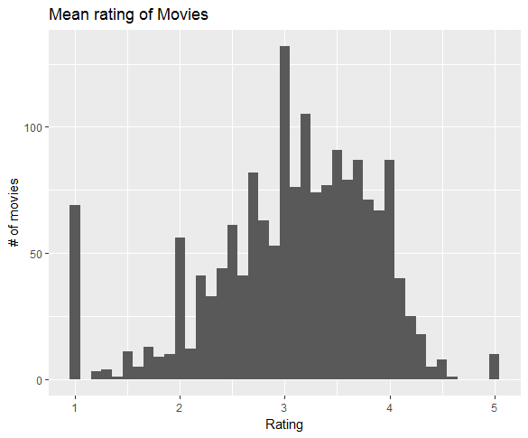
VISUALIZATION

Slide 20
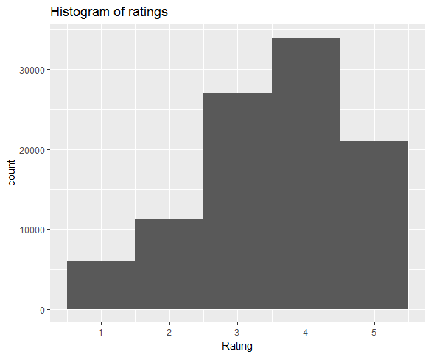
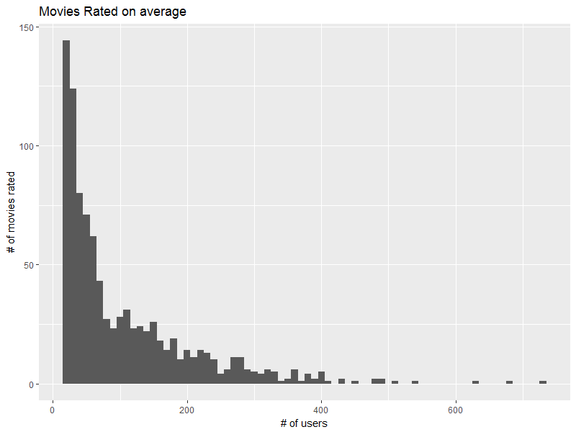
CONTINUE..

Slide 21
CONCLUSION
WE PREDICT THE TOP n MOVIES FROM A MOVIELENSE DATA SET.
SO THAT WE CAN RECOMMEND THIS MOVIE TO OTHER PERSONS

Slide 22
Thank You…

Slide 23
Any Queries..???

